Slide 1

Brownfields Grant Funding – FY 26
Tuesday, September 23rd
Kathleen Knox - CDPHE
Kate Lucas, AICP – KSU TAB
ksutab.org

Slide 2

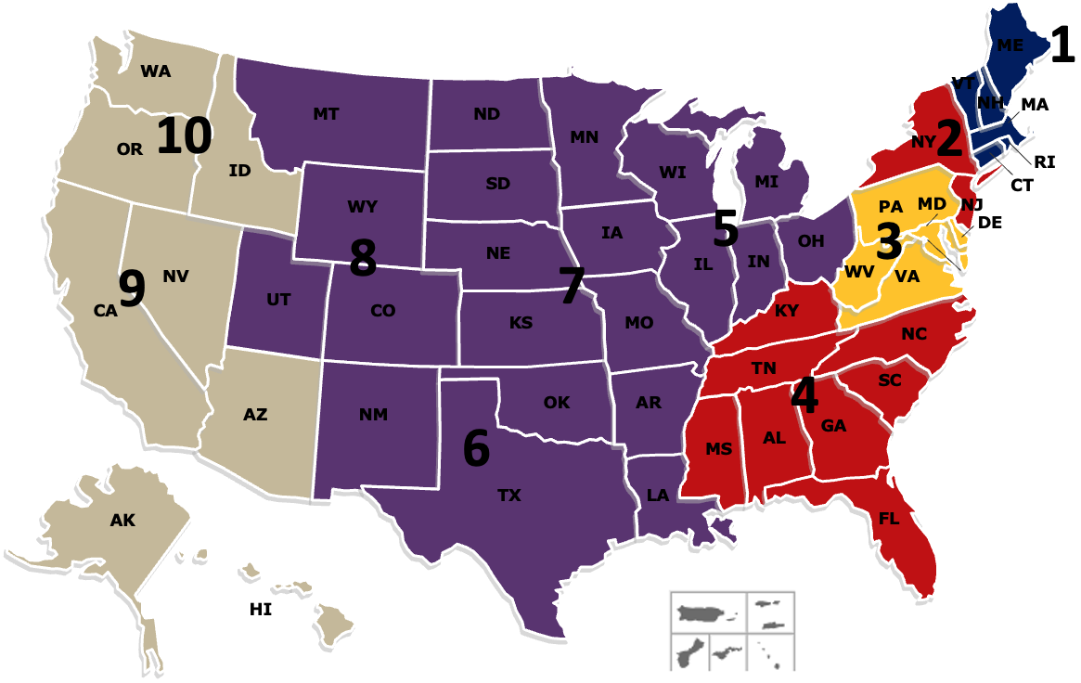






Technical Assistance to Brownfields (TAB)
What is TAB?
A national program funded by U.S. EPA
Dedicated TAB services provider for each EPA region & a dedicated TAB services provider for all federally recognized Tribes & Alaska Native villages
Services provided are FREE and tailored to address specific community needs
Assist communities and tribes with the brownfield assessment, cleanup and redevelopment process
Planning, environmental and economic development expertise
Webinars, workshop, e-tools (e.g., BiT, TAB EZ) and online resources
And much, much more…
Who are the TAB Service Providers?
  University of Connecticut – EPA Region 1
  New Jersey Institute of Technology (NJIT) – EPA Regions 2 & 4
  The West Virginia University – EPA Region 3
  Kansas State University – EPA Regions 5, 6, 7 & 8
  Center for Creative Land Recycling (CCLR) – EPA Regions 9 & 10
  KSU – ITEP – ANTHC – Tribal TAB

Slide 3

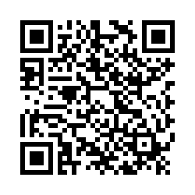

We Want to Hear Your Feedback
Please provide feedback on today’s event:
Click this link
https://kstate.qualtrics.com/jfe/form/SV_29u6CcVC0jo4nlk
Click the link provided in the chat box
Scan this QR image from your smartphone

Slide 4

Part 1: EPA
Brownfield Grants

Slide 5

What We Know about FY 2026 Changes...So Far
Potentially some formatting changes to the guidelines
Guidelines and narrative prompts may be getting "back to basics"
Questions involving EJScreen and the Climate and Environmental Justice Screening Tool (CEJST) will likely be removed

Slide 6
Assessment Grants
Community-Wide Assessment Grants
  Best fit for single communities starting a brownfield program
  Good for a single community (sometimes two)
  Up to $500,000 (IIJA)
  Four-year performance period
  Eligible activities include creating inventories, characterizing and assessing brownfield sites, conducting a range of planning activities, developing site-specific cleanup plans, and conducting community engagement
  You can apply for additional assessment funding once you have spent 70% of your original funding
  EPA anticipates awarding 70 CWA Grants in 2026

Slide 7
Assessment Grants
Assessment Coalition Grants
  Best fit for 3-5 communities starting a brownfield program
  One “lead” entity with 2-4 partners with less capacity
  Lead entity must be a state, county, Indian tribe, regional council, or general purpose unit of local government
  Up to $1,500,000
  Four-year performance period
  Eligible activities include creating inventories, characterizing and assessing brownfield sites, conducting a range of planning activities, developing site-specific cleanup plans, and conducting community engagement
  You can apply for additional assessment funding once you have spent 70% of your original funding
  EPA anticipates awarding 39 Coalition Assessment Grants in 2026

Slide 8
Assessment Grants
Community Wide Assessment Grants for States and Tribes (CWAGST)
  Only available to states, Tribes, and eligible native corporations in Alaska
  Up to $2,000,000
  Five-year performance period
  Eligible activities include creating inventories, characterizing and assessing brownfield sites, conducting a range of planning activities, developing site-specific cleanup plans, and conducting community engagement
  Current grantees may apply for additional assessment funding once they have spent 70% of their original funding
  EPA anticipates awarding 18 CWA Grants in 2026

Slide 9
Cleanup Grants
More focused scope: typically 1 large site or 2-3 smaller sites
Sites must be fully characterized before applying
You must own the site(s) before applying
Applications must have a letter from the state confirming eligibility
Two thresholds of funding: Up to $500,000 and up to $4 million
Four-year performance period
Eligible activities include cleanup, purchase of environmental insurance, and health monitoring.
You can apply for additional cleanup funding once you have spent 70% of your original funding, but you CANNOT apply for additional funding for the same project
  You may be able to obtain multiple rounds of funding by breaking a large site into 2+ projects.
EPA anticipates awarding 10 $500,000 Cleanup Grants and 26 $4 million Cleanup Grants in 2026

Slide 10
Multipurpose Grants
Allows both assessment and cleanup activities
Must conduct at least one Phase II ESA, one site cleanup, and an overall plan for revitalization
You must own one or more sites in the target area before applying
  Unlike cleanup grants, you may change which site you clean up with a multipurpose grant
Up to $1 million (IIJA)
Five-year performance period
Eligible activities include inventorying sites, conducting community engagement, conducting environmental assessments, cleanup planning and implementation, and area-wide planning
EPA anticipates awarding 20 Multipurpose Grants in 2026

Slide 11
Part 2: What to Know
Before You Begin

Slide 12

First Things First….Do You Need an EPA Grant?
What is the scope of my brownfield problem?
Do I have multiple eligible sites or just one?
What is/are my target area(s)?
What work is needed? Planning? Assessment? Cleanup? Other?

Slide 13
First Things First….Do You Need an EPA Grant?
Does the timing of the grant work for the needs of the community?
Does your organization have the capacity to manage an EPA grant:
  Technical/Communications capacity
  Financial Management capabilities
  Contractor Management systems
If capacity is an issue, do you have a logical partner (regional entity, economic development organization, etc.) that can assist with gaps in capacity?
Reach out to your state brownfields agency if you aren’t ready for an EPA grant.

Slide 14
Why Apply Now?
FY 26 is the last year of IIJA Funding
FY27 EPA will only receive their annual “regular” appropriations
  About $90 M vs < $270M/year for Assessment, Cleanup, Revolving Loan Fund (RLF), Multipurpose, and Job Training Grants
  Community-Wide Assessment grants will be limited to $300K/grant
  Cleanups will be limited to $500K/site
  Cost share will return for Cleanup, Multipurpose, and Revolving Loan Grants

Slide 15

READY? LET’S GO FOR IT!!
EPA FY26 Guidelines will be released in September
When current guidelines aren’t available…review last year’s grant guidelines and FAQs
https://www.epa.gov/brownfields/marc-grant-application-resources
Example of past successful grant applications are available on KSU TAB’s resources webpage.
You can narrow down by year
Check out the successful grant application for ideas and strategies.
  https://ksutab.org/resources?cat=sample
Go to www.ksutab.org – select TABEZ: your one-stop shop for your EPA Brownfields Assessment, Multipurpose, and Cleanup application guidance!

Slide 16

Grants.gov
Check in with grants.gov early to make sure you’re able to submit your grant AND your password is current…
Or identify the person in your organization who understands the process and all the buzzwords such as…UEI identifier (replacing DUNS #), SAM (system for award management), AOR (authorized organization representative), and e-biz POC (e-business point of contact)
Or…contact other local communities/regional organizations that have applied in the past for mentoring on navigating grants.gov, SAM, and AOR selection
https://www.grants.gov/web/grants/applicants/applicant-faqs.html#UEI

Slide 17
Grants.gov
Confirm UEI # and Registration With SAM (System For Award Management)
If you have already registered with SAM, you have been assigned the UEI #, but make sure your account is active
Complete an AOR (Authorized Organization Representative) profile and track status on www.grants.gov
The Approved AOR must be the person who submits the application package – the AOR organization is the applicant!

Slide 18
Before Pen Hits Paper: Start with a great project rather than a great grant
If you have questions, contact your regional EPA office regarding your eligibility to apply, site eligibility for funding, and legal questions regarding property ownership
  Grant Strategy and Identification of Target Areas – EPA cannot assist once guidelines are out but you can contact TAB anytime
  EPA can answer questions about eligibility at any time
Review EPA FY2025 Guidance for Assessment and Cleanup grants, or FY2024 Guidance for Multipurpose grants
TAB EZ: Check out the TAB EZ grant writing tool at ksutab.org and explore how it outlines criteria specific to your grant

Slide 19
A Few To-Dos:
Review a few successful applications from previous years.
Reach out to CDPHE for a support letter now – these take time to draft!
If you’re not certain if your project is eligible, reach out to EPA Region 8 for an eligibility determination. Note that asbestos contamination can be a bit of a gray area.
If you’re applying for a cleanup grant, you must post your draft ABCA and hold a public meeting at least 2 weeks prior to submitting the grant.
Note that for cleanup grants, you will need a Phase I, Phase II, and ABCA – if you don’t have these already (or they will be complete soon), it is likely too late to apply this year.

Slide 20
Part 3: Section Overview

Slide 21
EACH GRANT HAS INDIVIDUAL EPA RANKING CRITERIA
Ranking Criteria for EPA Brownfields Grants (FY 25-new guidelines issued in September 2025) | Community-Wide Assessment/CWAGST | Assessment Coalition | Cleanup | Multipurpose (FY 2024)
Project Area Description/Plans for Revitalization | 40 pts | 45 pts | 55 pts | 45 pts
Community Need and Community Engagement | 40 pts | 40 pts | 40 pts | 45 pts
Task Description, Cost Estimates, Measuring Success | 45 pts | 45 pts | 55 pts | 45 pts
Programmatic Capability and Past Performance | 35 pts | 35 pts | 30 pts | 35 pts
Total | 160 pts | 165 pts | 180 pts | 170 pts
Notes:
Len has a comment

Slide 22
Key Reminders
Communicate who you are: Remember a person reading your proposal has probably never heard of your town.
How does your location influence identity?
~Does your community face challenges due to your location?
~Is the landscape part of what makes you unique?
Who are you as a community, and how does this project support that identity?
~Agricultural, tourism, and industrial communities all have different needs.
How does your community and your project fit into a bigger picture?
~ Is your project in keeping with a larger state or national initiative?
~Can your project address a community need in a substantive way?

Slide 23
Section 1: Project Area Description and Plans for Revitalization
Project Area Description and Plans for Revitalization
  Target Area and Brownfields
    Overview of Brownfield Challenges and Description of Target Area
    Description of the Priority Brownfield Site(s)
    Identifying Additional Sites
  Revitalization of the Target Area
    Reuse Strategy and Alignment with Revitalization Plans
    Outcomes and Benefits of Reuse Strategy
  Strategy for Leveraging Resources
    Resources Needed for Site Reuse
    Use of Existing Infrastructure

Slide 24

Target Area and Brownfields
The background section should set the stage for a cohesive story where the affected population directly benefits from the cleanup or assessment activities.
Make a BRIEF but passionate case
Identify a specific issue based on past history
Identify priority sites in your target area with past and current land uses and environmental conditions. Be specific yet concise.
  Why are the sites a priority?
  How do they impact the affected populations?
Note how you will go about identifying additional sites if needed
Consider your target area location: is it near environmentally or socially sensitive receptors?
Often times the project description is not where people lose significant points, but not defining the exact issue being addressed carries through the entire proposal. A poorly defined proposal will not get funded.

Slide 25
Thread the Story Throughout
Project Description: Example
Lack of business opportunities, job loss, shattered economy
There is insufficient quality housing to attract new businesses and health of residents is impacted
Housing site chosen as a priority for abatement
Providing housing will reduce health impacts and improve economic conditions moving forward.

Slide 26
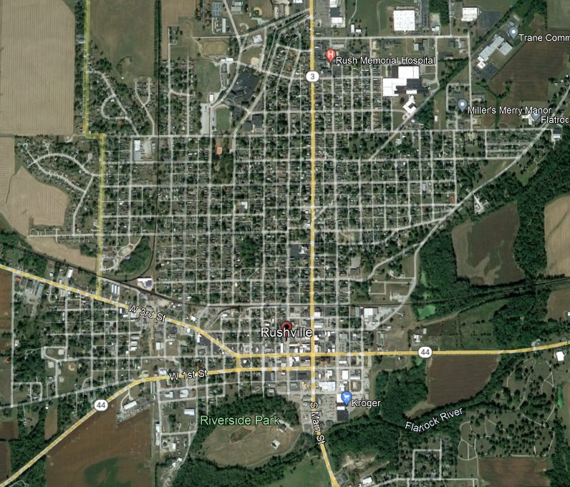
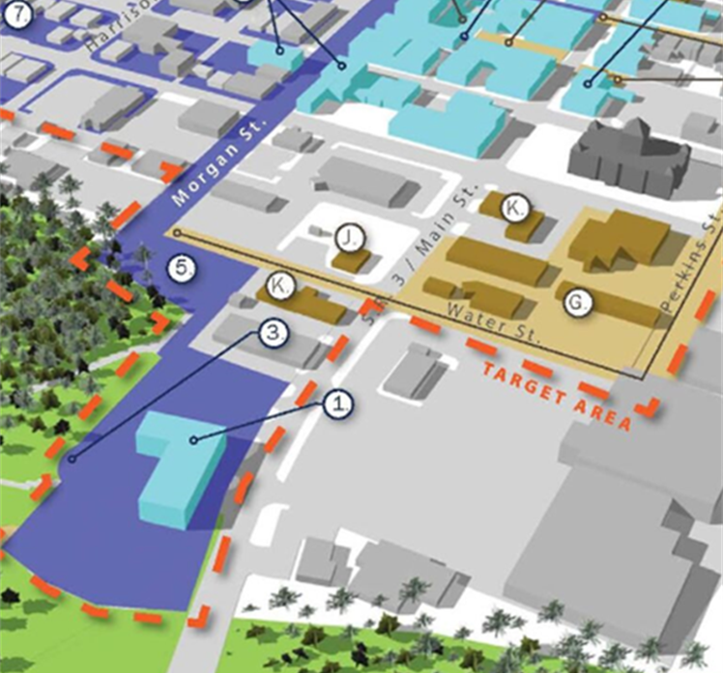
Target Area and Brownfields
Geographic Boundary(ies)
Boundary(ies) in which work can be performed (formerly referred to as “jurisdiction”
Include discussion of brownfields challenges/impacts w/in boundary
(not industrial/cultural history)
How will this grant address these challenges!!!!
Target Area(s)
Within the geographic boundary(ies), specific target area(s) where you plan to focus grant activities, such as a neighborhood, district, corridor, or census tract.
Geographic Boundary(ies) Target Area (s)
KSU TAB 2023 GW Training Series: Webinar #3
https://www.ksutab.org/?ResponseView=TABResourceDownloadView&id=4935

Slide 27
Section 2: Community Need and Community Engagement
Community Need and Community Engagement
  Community Need
    The Community’s Need for Funding
    Threats to Sensitive Populations
      Health and Welfare of Sensitive Populations
      Greater than Normal Incidence of Disease and Adverse Health Conditions
      Environmental Justice
        Identification of Environmental Justice Issues
        Advancing Environmental Justice
  Community Engagement
    Project Involvement
    Project Roles
    Incorporating Community Input

Slide 28
The Community’s Need for Funding
Tie Into History and Challenges
Why is your community unable to secure funding for brownfield activities?
What financial information can you provide to demonstrate your need?
Possible information to convey includes job losses and unemployment rates, very low tax base, poverty among residents, all leading to no other funding for brownfields.
What sensitive populations exist in your target area?
Sensitive populations can include children, pregnant women, elderly, minority, low-income communities and others.
How will your project address or facilitate the reduction of threats of these sensitive populations?

Slide 29


Community Engagement
Project Involvement, Project Roles, Incorporating Community Input
Ensure engagement is happening with the populations identified in the sections above
  Do you need translators?
  What methods will be used to engage? – keep in mind access to web services
  Involve the youth
  Consider local workforce when scheduling meeting times and days
Incorporating input is just as important as sharing information.

Slide 30
Section 3: Task Descriptions, Cost Estimates, and Measuring Progress
Task Descriptions, Cost Estimates, and Measuring Progress
  Description of Tasks/Activities and Outputs
    Project Implementation
    Anticipated Project Schedule
    Task/Activity Lead
    Outputs
  Cost Estimates
  Plan to Measure and Evaluate Environmental Progress and Results

Slide 31
Section 3: Task Descriptions, Cost Estimates, and Measuring Progress
Task(s)/Activities | What? | Example Tasks: Program Management, Community Outreach, Assessment, Cleanup and Reuse Planning
Implementation | How? | Develop, procure, manage, execute… (Action Verbs!)
Schedule | When? | By 2nd quarter, By end of 2nd year, etc.
Lead | Who? | County, City, QEP, Consultant, Project Dir., etc.
Outputs | Metrics? | Executed MOA, 20 quarterly reports, at least four ACRES property profiles, Fund Manager Agreement, Underwriter and Appraisal contracts, CIP, community input, etc.

Slide 32
Outputs & Outcomes / Anticipated Benefits
Project Description
TASK DESCRIPTIONS, BUDGET TABLE, & BUDGET NARRATIVE
Engagement, Planning, Assessment, Cleanup
Community Needs & Engagement
Task descriptions, the budget table and budget narrative are the brief summary of ‘what’ your funding will do to achieve your goals.
‘Money talks . . . BS Walks’

Slide 33
Section 4: Programmatic Capability and Past Performance
Programmatic Capability and Past Performance
  Programmatic Capability
    Organizational Capacity
    Organizational Structure
    Description of Key Staff
    Acquiring Additional Resources
  Past Performance and Accomplishments
    Currently Has or Previously Received an EPA Brownfield Grant
      Accomplishments
      Compliance with Grant Requirements
    Has Not Received an EPA Brownfields Grant bus has Received Other Federal or Non-Federal Assistance Agreements
      Purpose and Accomplishments
      Compliance with Grant Requirements
    Never Received Any Type of Federal or Non-Federal Assistance Agreements

Slide 34
Section 4: Programmatic Capability and Past Performance
Ok, now you’re near the end, but don’t treat this as a downhill slide to the finish!
Treat this as you would a resume, this is the time to shine a positive light on you and the team who will be involved in managing this grant.
As with a resume, highlight all your credentials and relevant experience!
You want EPA to know that you and your team have what it takes to make this project a success.

Slide 35
Part 4: State Resources

Slide 36



State-Level Resources
State Level
  Phase I and Phase II ESAs
  Cleanup Planning and ABCAs
  Cleanup Grants
  Asbestos Pilot Program Grants
  Revolving Loan Fund
  Voluntary Cleanup Program
  Brownfield Tax Credits
  Petroleum Storage Tank Fund
Colorado Brownfields Partnership
  Planning and Technical Assistance

Slide 37
State-Level Resources
State of Colorado IIJA Grant Writing Assistance
https://dlg.colorado.gov/grant-writing-assistance-program
Local governments, special districts, housing authorities, and Tribes in Colorado can apply for no cost grant review/writing or project planning assistance
Applications are accepted on a rolling basis while funding is available through the Governor’s Office of Economic Recovery
Program lead times may not be able to accommodate an FY26 EPA grant application

Slide 38
State-Level Contacts
Targeted Brownfields Assessment Program
  Kathleen Knox - kathleen.knox@state.co.us
  Mark Rudolph - mark.rudolph@state.co.us
Brownfields Cleanup Grants
  Kyle Sandor - kyle.sandor@state.co.us
Voluntary Cleanup Program & Tax Credits
  Fonda Apostolopoulos - fonda.apostolopoulos@state.co.us
Revolving Loan Fund
  Mark Rudolph - mark.rudolph@state.co.us
  Ryan Terbush - rterbush@chfainfo.com

Slide 39
Part 5: Wrap Up

Slide 40

For More Information
FY 25 Grant Application Webinar Recording: https://www.ksutab.org/event/knock-it-out-parc-epa-brownfield-grant-application-workshop
Grant Writing Office Hours
  Friday, September 19, 2025 | 10 AM - 12 PM MT
  Tuesday, September 23, 2025 | 3 PM - 5 PM MT
  Thursday, October 9, 2025 | 1 PM - 3 PM MT
https://ksu.zoom.us/j/91736710514

Slide 41
We Want to Hear Your Feedback
Please provide feedback on today’s event:
Click this link
https://kstate.qualtrics.com/jfe/form/SV_29u6CcVC0jo4nlk
Click the link provided in the chat box
Scan this QR image from your smartphone

Slide 42
Thank You
For joining us for this webinar. Please get in touch if you have any questions
or comments: katelucas@ksu.edu.
This project has been funded wholly or in part by the United States Environmental Protection Agency under assistance agreement (41-84066501) to Kansas State University. The contents of this document do not necessarily reflect the views and policies of the Environmental Protection Agency, nor does the EPA endorse trade names or recommend the use of commercial products mentioned in this document.
ksutab.org

